Slide 1
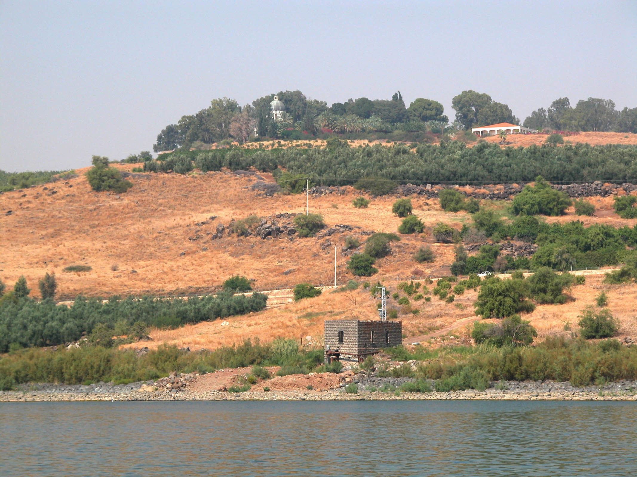
Matthew 6.19-34: Treasure and Provision
Possible site of the Sermon on the Mount and/or Sermon on the Plain, looking north from the Sea of Galilee.
Photo ©2012 Todd Bolen / BiblePlaces.com.

Slide 2
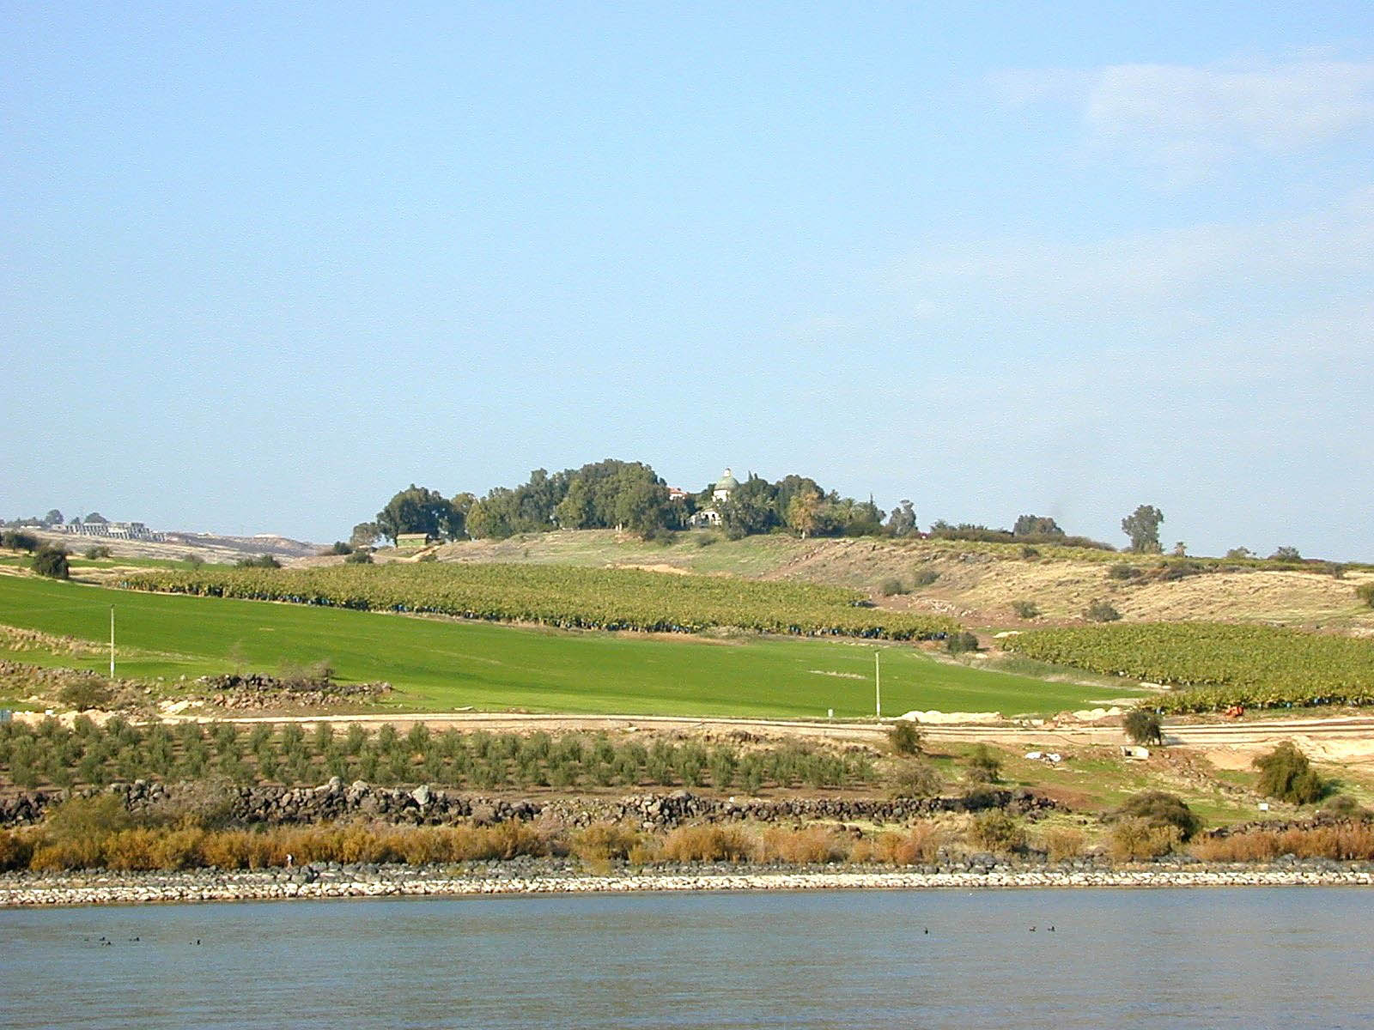
Matthew 6.19-20 NET: “Do not accumulate for yourselves treasures on earth, where moth and rust destroy and where thieves break in and steal.
But accumulate for yourselves treasures in heaven, where moth and rust do not destroy, and thieves do not break in and steal.”
Photo ©2012 Todd Bolen / BiblePlaces.com.

Slide 3
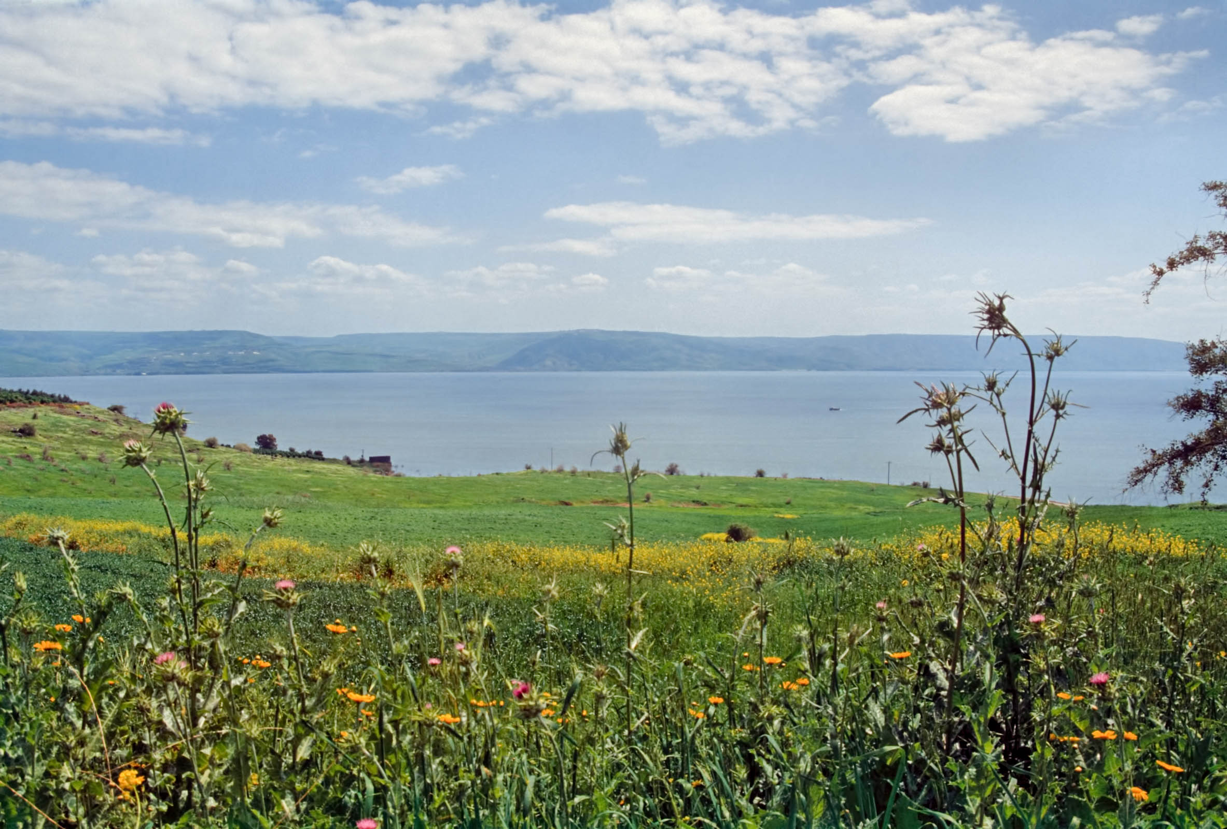
Matthew 6.19: “Do not accumulate for yourselves treasures on earth, where moth and rust destroy and where thieves break in and steal.”
things here are temporal and temporary
Looking toward the Sea of Galilee
Photo ©2012 Todd Bolen / BiblePlaces.com.

Slide 4
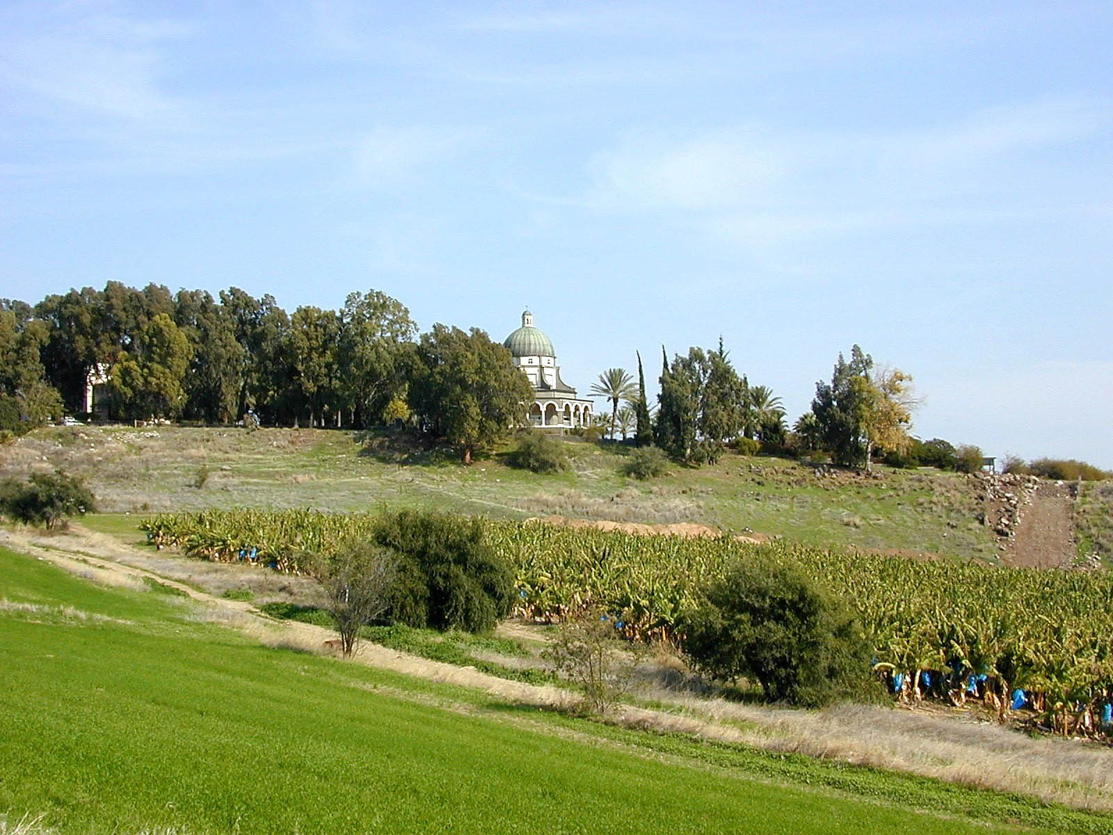
Matthew 6.20: “accumulate for yourselves treasures in heaven, where moth and rust do not destroy, and thieves do not break in and steal.”
Church on the site financed by Mussolini!
Photo ©2012 Todd Bolen / BiblePlaces.com.

Slide 5
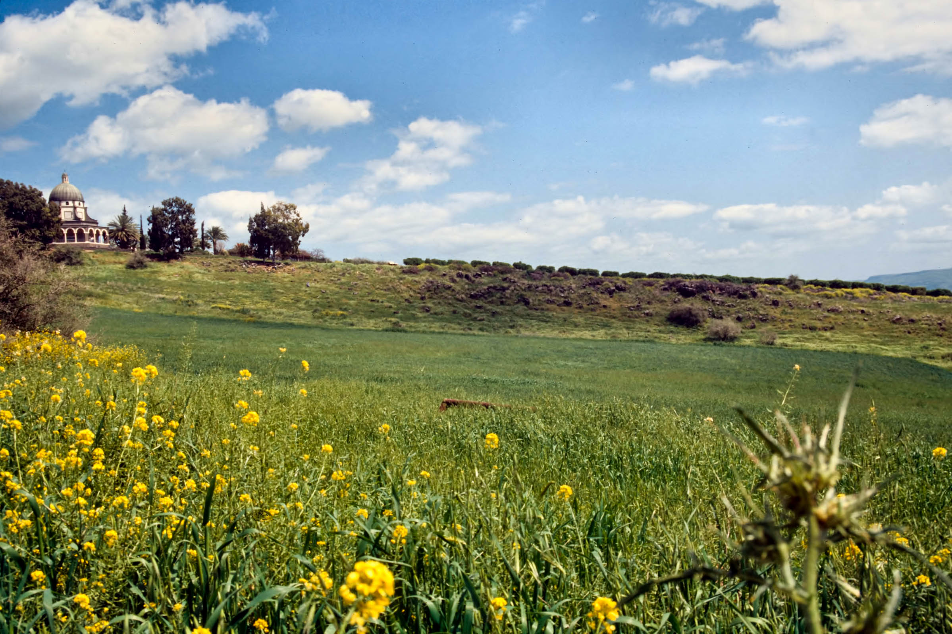
Matthew 6.21-24: “For where your treasure is, there your heart will be also. The eye is the lamp of the body. If then your eye is healthy, your whole body will be full of light. But if your eye is diseased, your whole body will be full of darkness. If then the light in you is darkness, how great is the darkness! No one can serve two masters, for either he will hate the one and love the other, or he will be devoted to the one and despise the other. You cannot serve God and money.”
Photo ©2012 Todd Bolen / BiblePlaces.com.

Slide 6
Matthew 6.21: “For where your treasure is,
there your heart will be also.”
Photo ©2012 Todd Bolen / BiblePlaces.com.

Slide 7
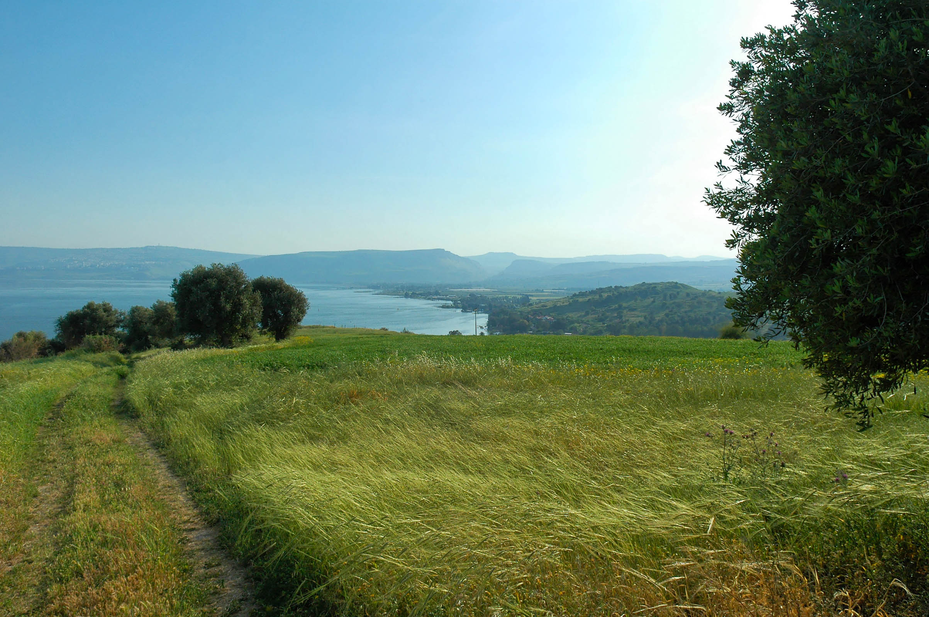
Matthew 6.22-23: “The eye is the lamp of the body. If then your eye is healthy, your whole body will be full of light. But if your eye is diseased, your whole body will be full of darkness. If then the light in you is darkness, how great is the darkness!”
Photo ©2012 Todd Bolen / BiblePlaces.com.

Slide 8
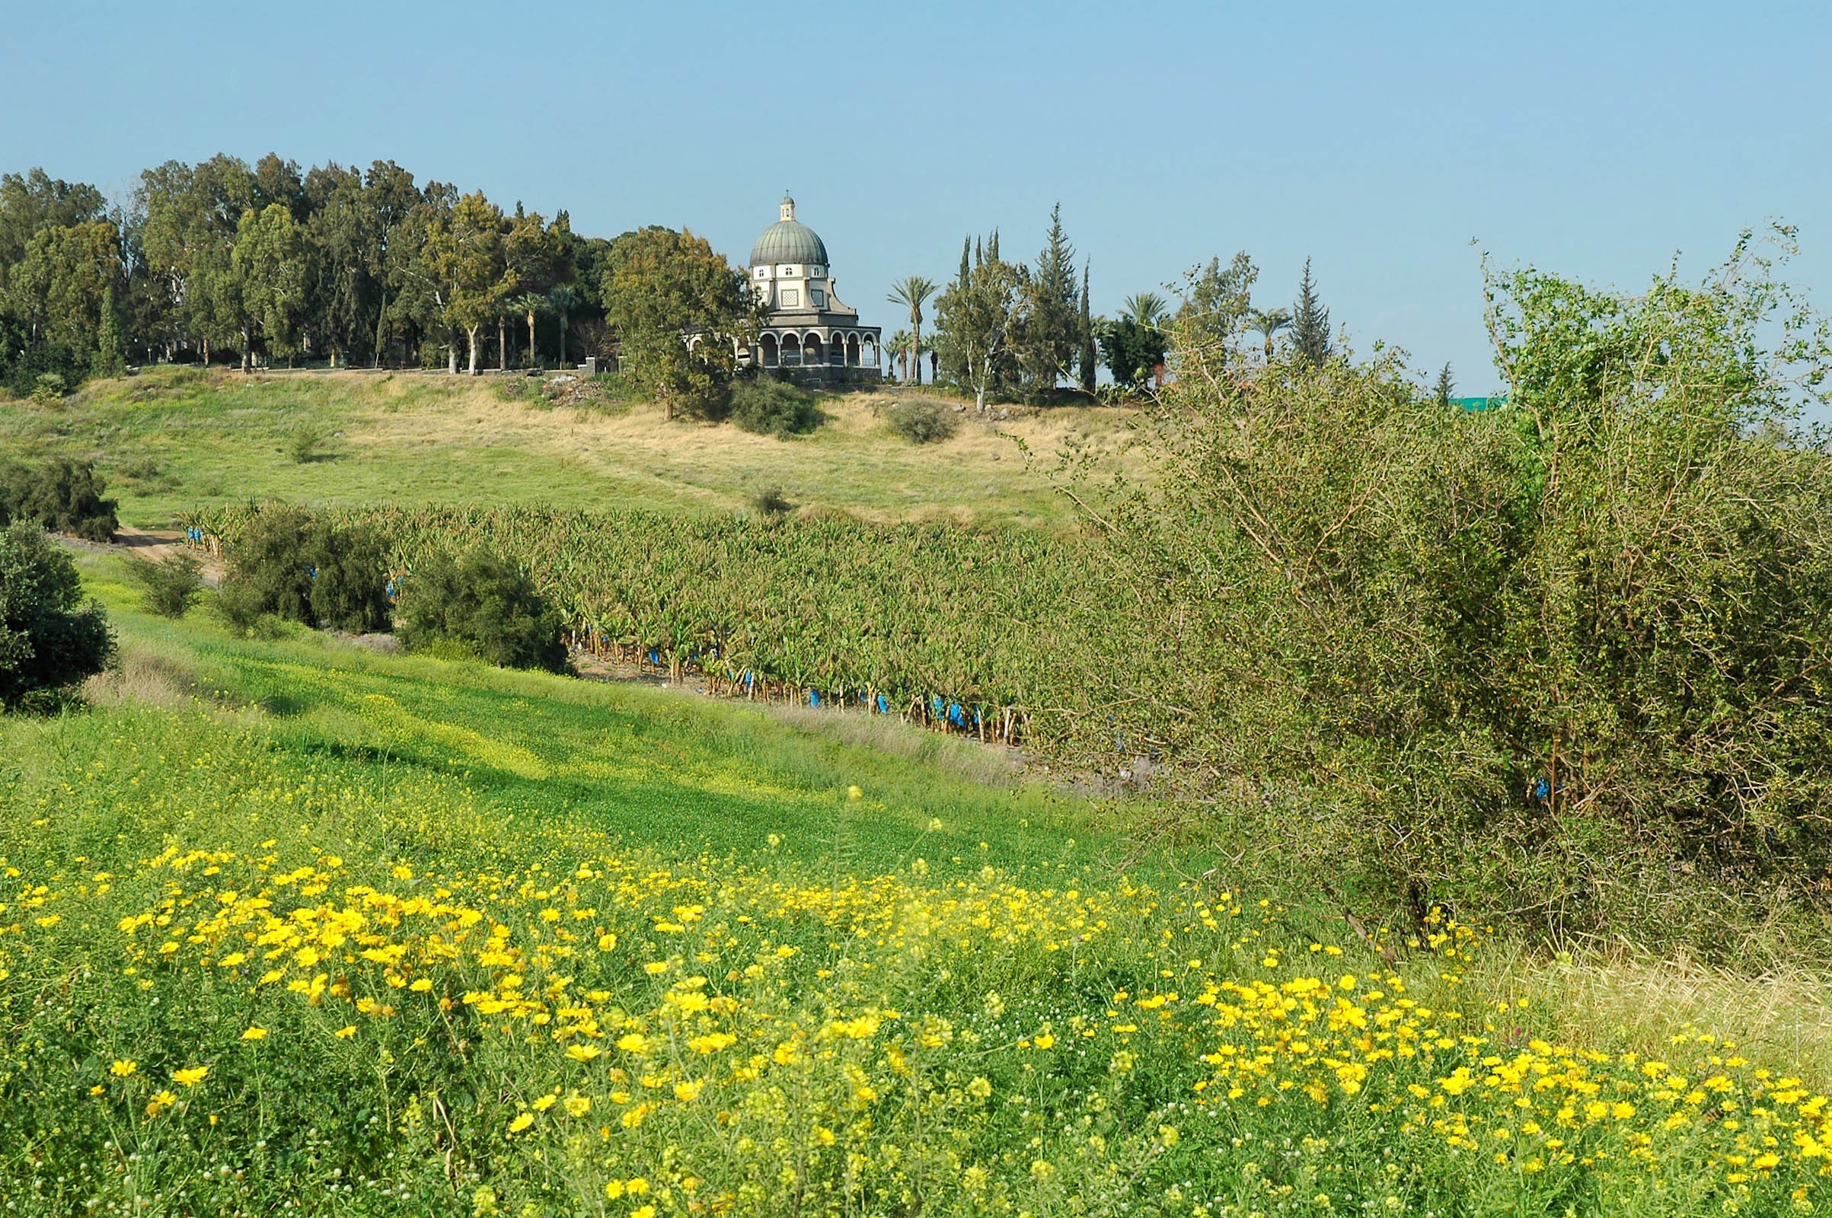
Matthew 6.24: “No one can serve two masters, for either he will hate the one and love the other, or he will be devoted to the one and despise the other. You cannot serve God and money.”
Photo ©2012 Todd Bolen / BiblePlaces.com.

Slide 9
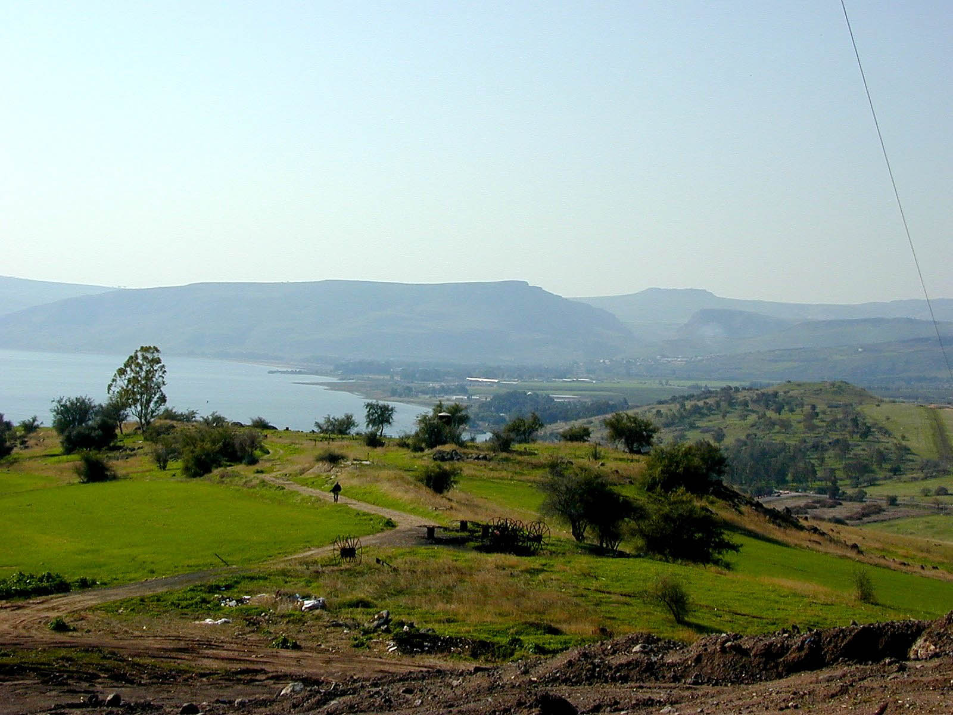
Matthew 6.25-26 NET: “Therefore I tell you, do not worry about your life, what you will eat or drink, or about your body, what you will wear. Isn't there more to life than food and more to the body than clothing? Look at the birds in the sky: They do not sow, or reap, or gather into barns, yet your heavenly Father feeds them. Aren't you more valuable than they are?”
Photo ©2012 Todd Bolen / BiblePlaces.com.

Slide 10
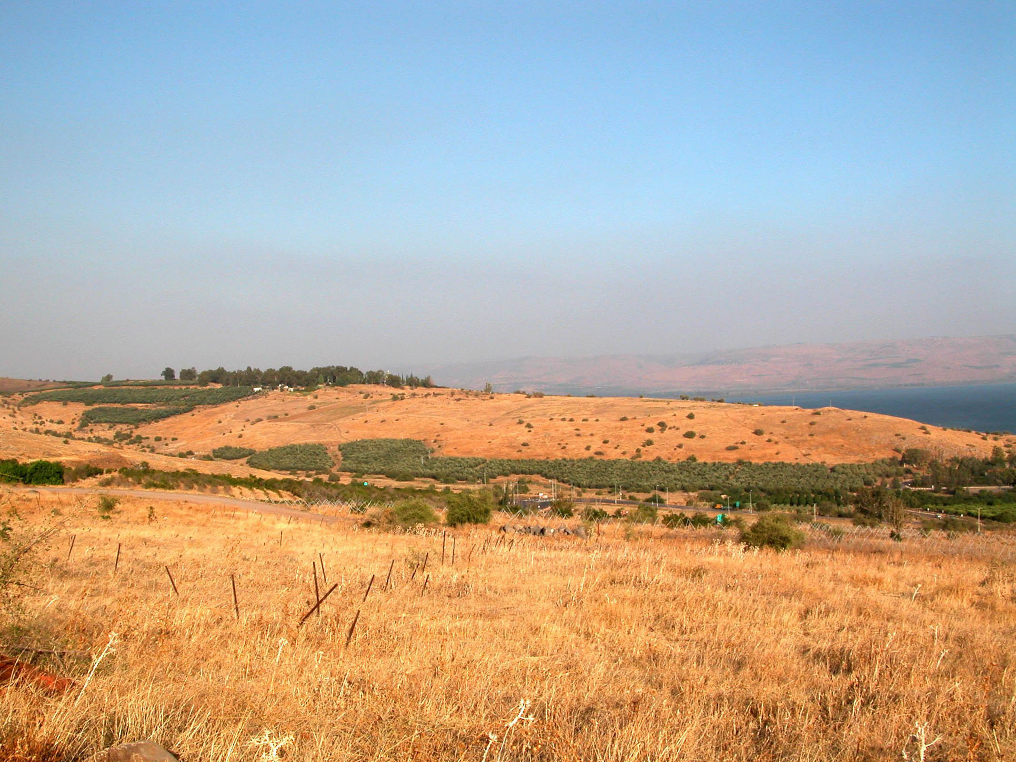
Matthew 6.27-30: And which of you by worrying can add even one hour to his life? Why do you worry about clothing? Think about how the flowers of the field grow; they do not work or spin. Yet I tell you that not even Solomon in all his glory was clothed like one of these! And if this is how God clothes the wild grass, which is here today and tomorrow is tossed into the fire to heat the oven, won't he clothe you even more, you people of little faith?”
Photo ©2012 Todd Bolen / BiblePlaces.com.

Slide 11
Matthew 6.31-34: “So then, don't worry saying, ‘What will we eat?’ or ‘What will we drink?’ or ‘What will we wear?’ For the unconverted pursue these things, and your heavenly Father knows that you need them. But above all pursue his kingdom and righteousness, and all these things will be given to you as well. So then, do not worry about tomorrow, for tomorrow will worry about itself. Today has enough trouble of its own.”
Photo ©2012 Todd Bolen / BiblePlaces.com.

Slide 12
Matthew 6.33: “But above all pursue his kingdom and righteousness, and all these things will be given to you as well.”
Photo ©2012 Todd Bolen / BiblePlaces.com.

Slide 13
Matthew 6.33: “But above all pursue his kingdom and righteousness, and all these things will be given to you as well.”
Photo ©2012 Todd Bolen / BiblePlaces.com.

Slide 14
Matthew 6.33 NASB: “But seek first His kingdom and His righteousness, and all these things will be added to you.”
Photo ©2012 Todd Bolen / BiblePlaces.com.

